Slide 1
9 B
WHITE GOLD (salt)

Slide 2


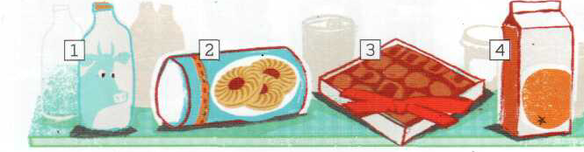
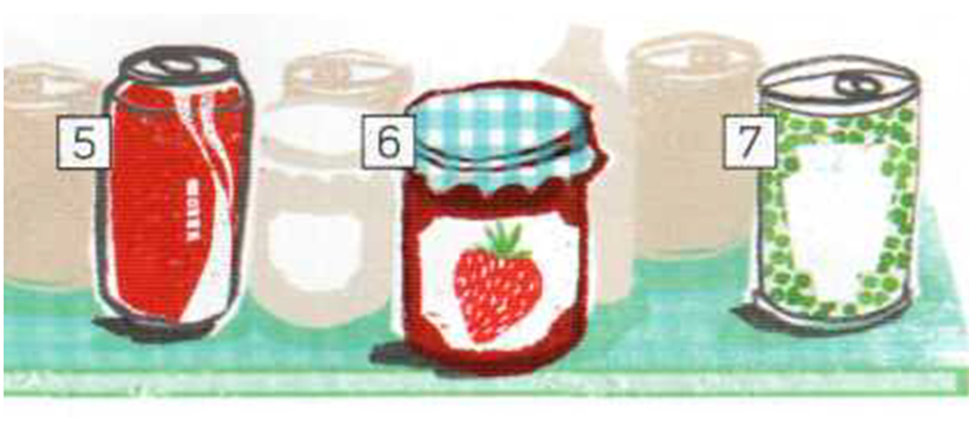
Please, repeat
And memorize
a bottle
a packet
a carton
a box
Dictation:
Listen and Write the following:
a can
a jar
a tin

Slide 3
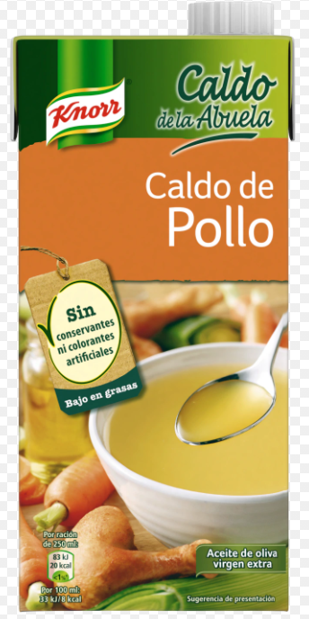
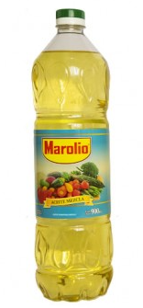
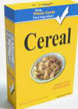
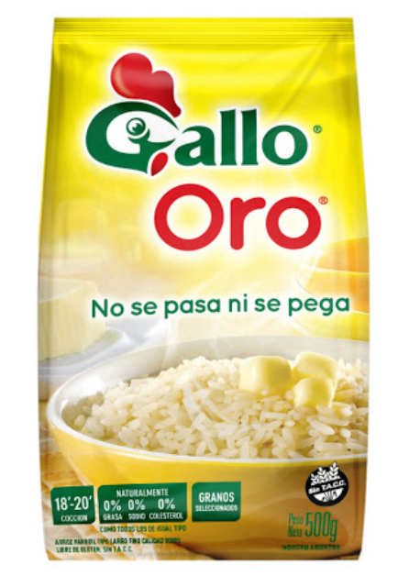
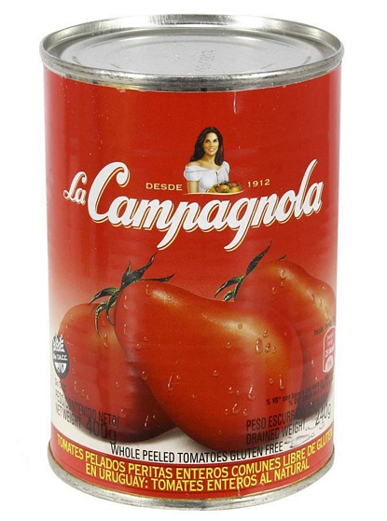
Dictation:
Listen and Write the following:
A bottle of oil
A packet of rice
A tin of tomatoes
A box of cereal
A carton of soup

Slide 4
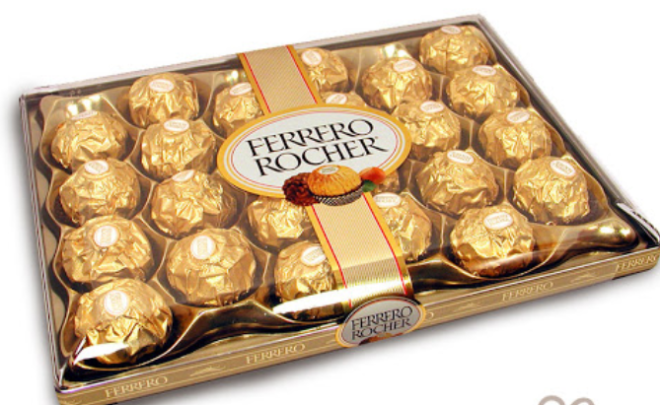
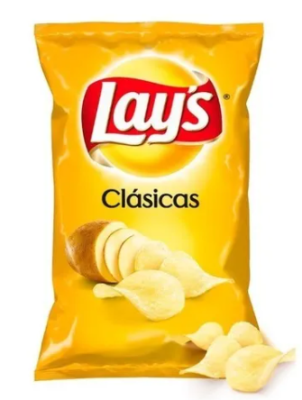
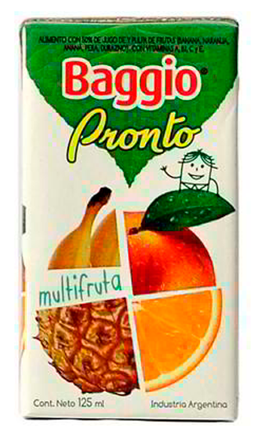
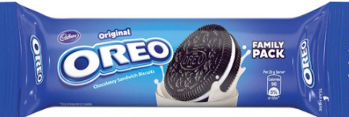
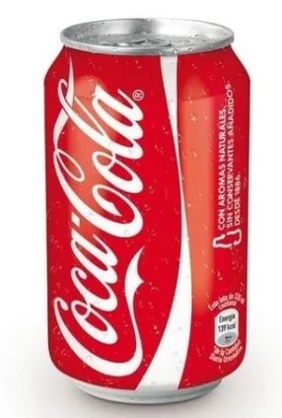
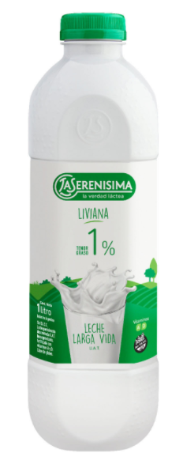
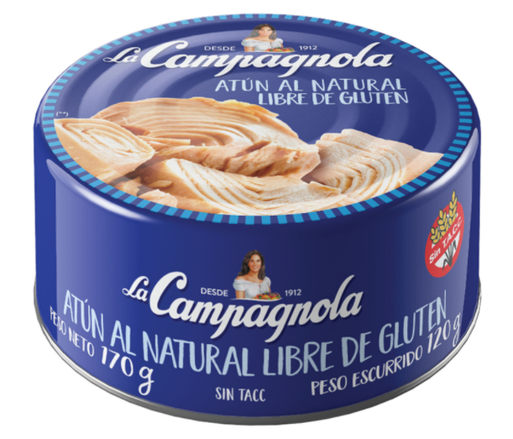
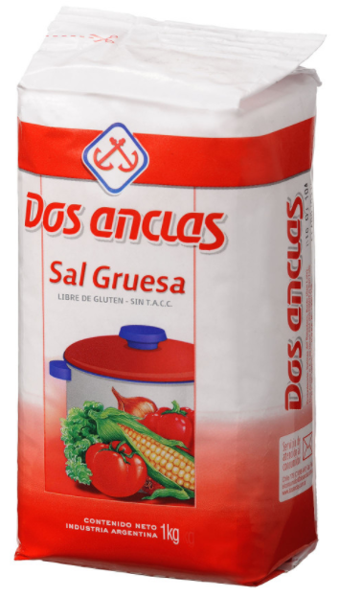
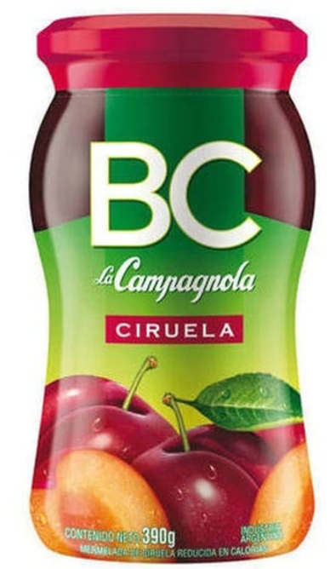
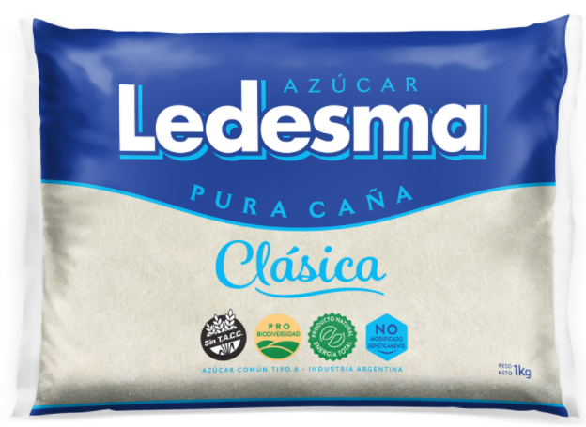
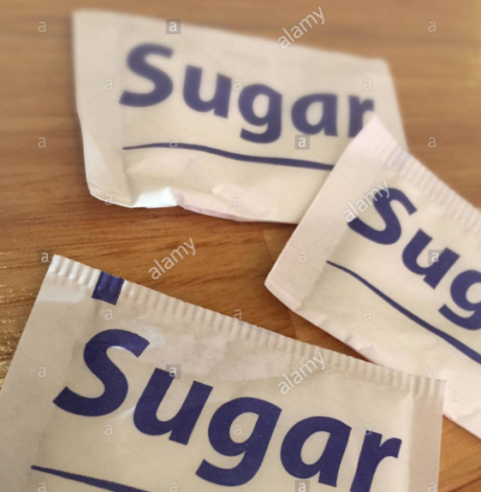
Make phrases with these words
a carton of juice
a box of chocolates
a packet of crisps
a packet of biscuits
a can of coke
a tin of tuna
a bottle of milk
a packet of sugar
Individual sugar packets
a jar of jam
a packet of salt

Slide 5
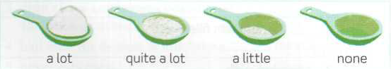
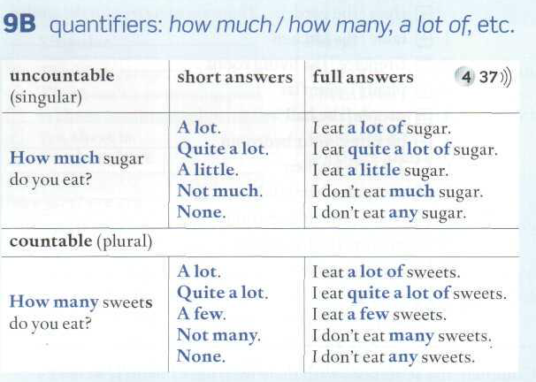
QUANTIFIERS
How much sugar is there in the spoon?
Look at these measuring spoons and answer:
How much sugar is there in the spoon?
There is a lot of sugar in the first spoon. (mucho)
There is quite a lot of sugar in the second spoon (bastante)
There is a little sugar in the third spoon (un poco. Noten que aquí no se usa of)
There is none in the fourth.
There is no sugar in the fourth
There isn´t any sugar in the fourth
When we use none we do not include the noun.
Study quantifiers at page 140
Listen and repeat. Memorize the short and the full answers.

Slide 6
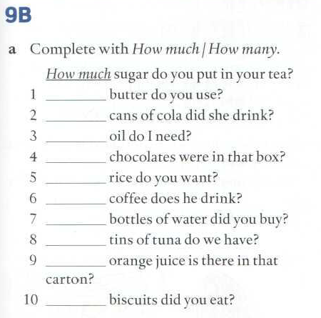
Student´s book page 141
First complete the sentences, then listen to check
How much
How many
How much
How many
How much
How much
How many
How many
How much
How many

Slide 7
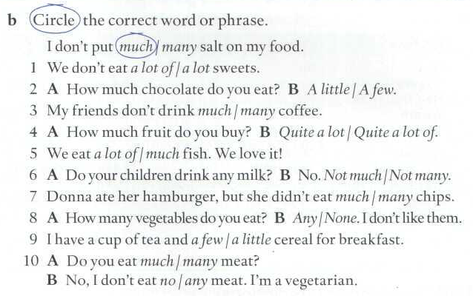
Do the exercise and then listen to check.
Remember we only use OF when the food item is mentioned, otherwise, we don´t use OF

Slide 8
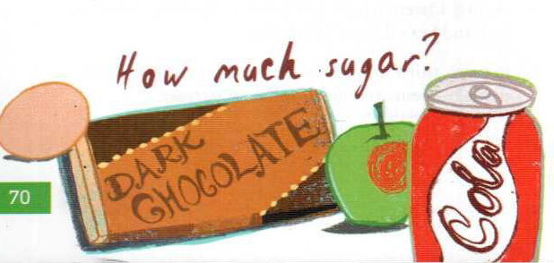
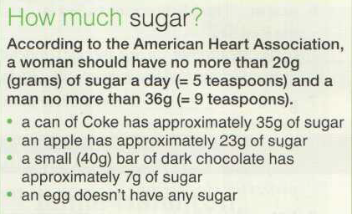

Pages 70 and 109
How much sugar is there in an egg?
How much sugar is there in dark chocolate (amargo)
How much sugar is there in an apple?
How much sugar is there in a can of coke?

Slide 9
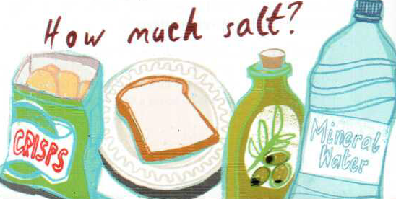
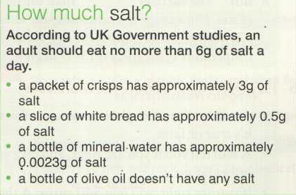
Pages 70 and 109
How much salt is there in a packet of crisps?
How much salt is there in a slice of white bread?
How much salt is there in a bottle of olive oil?
How much salt is there in a bottle of mineral water?

Slide 10
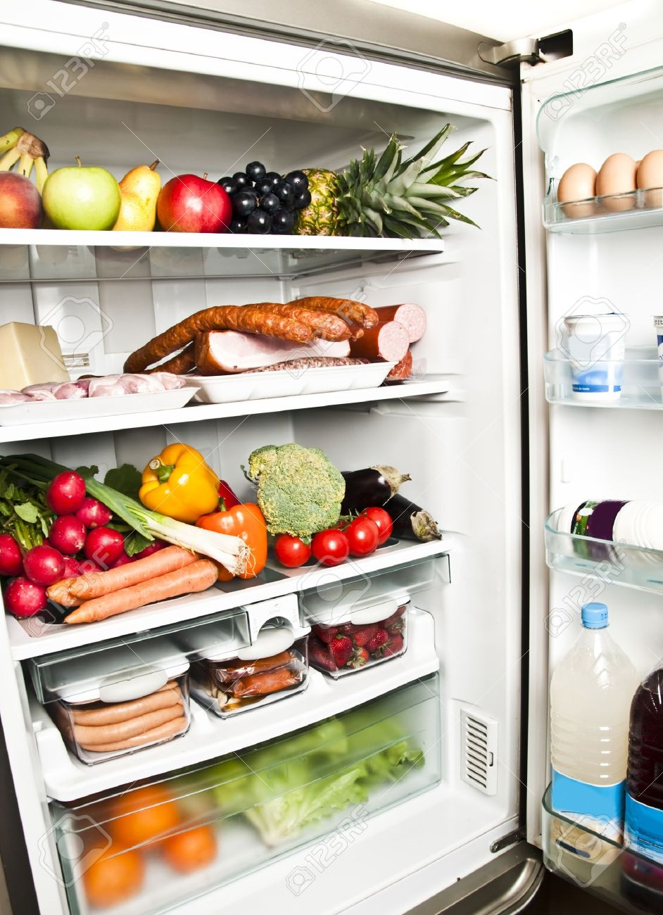
What do you have in your fridge?
What is there in your fridge?
What isn’t there in your fridge?

Slide 11
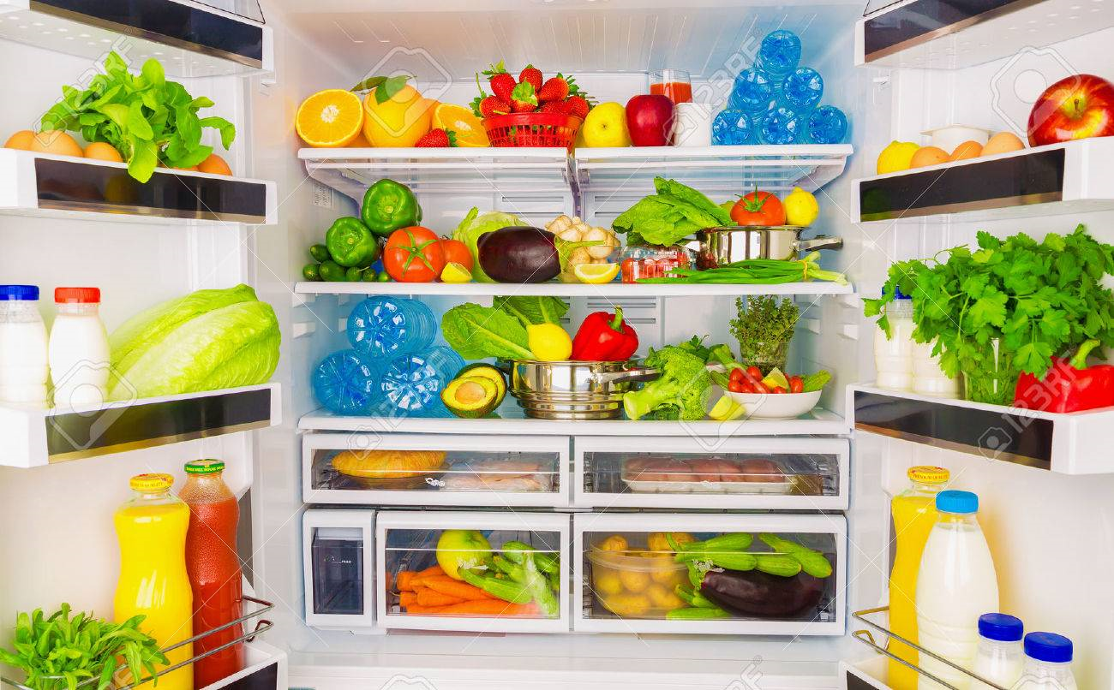

Slide 12
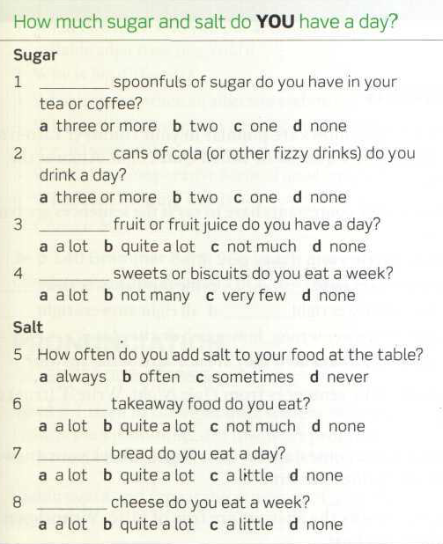
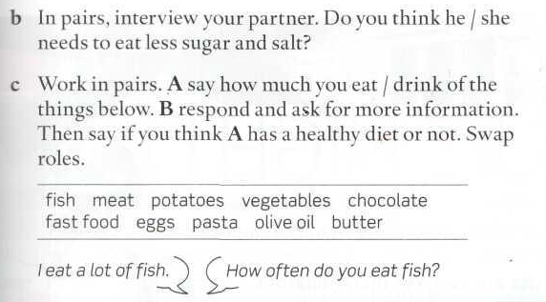

Slide 13
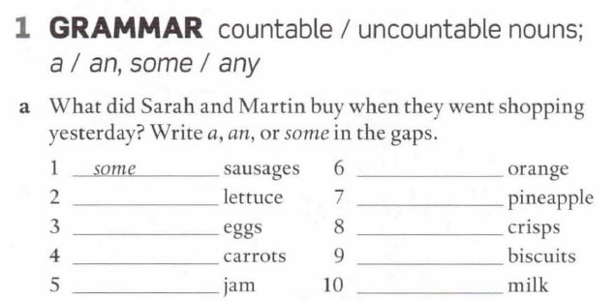
WB 56
an
Some/a
a
Some
Some
Some
Some
Some
Some

Slide 14
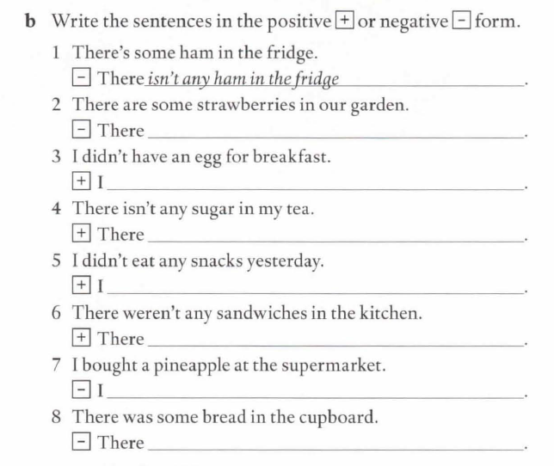
WB 56
aren’t any strawberries in our garden
had an egg for breakfast.
is some sugar in my tea.
ate some snacks yesterday-
were some sandwiches in the kitchen.
didn’t buy a pineapple at the supermarket.
wasn’t any bread in the cupboard.

Slide 15
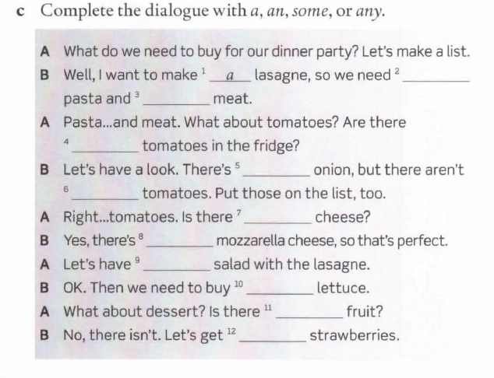
WB 56
some
some
any
an
any
any
some
some
some
any
some

Slide 16
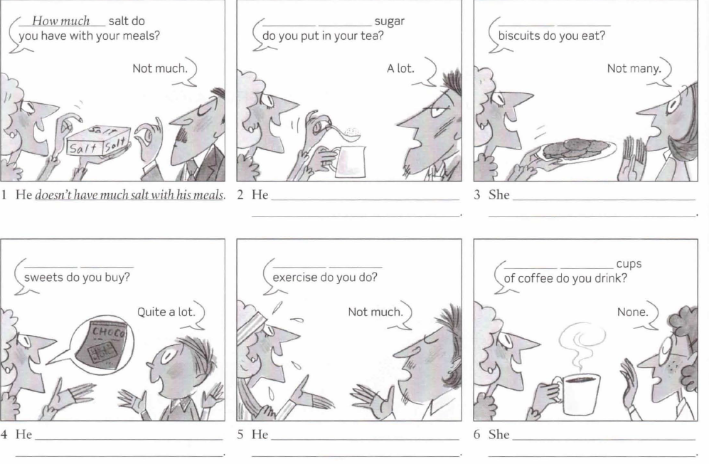
WB 58
How much
How many
puts a lot of sugar in his tea
doesn’t eat many biscuits
How many
How much
How many
buys quite a lot of sweets
Doesn´t do much exercise
doesn’t drink any cups of coffee

Slide 17
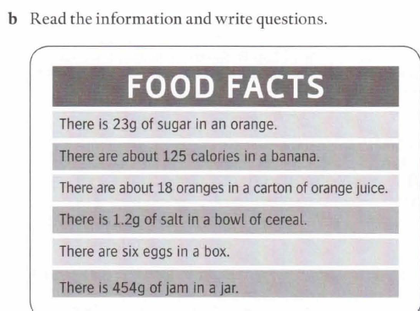
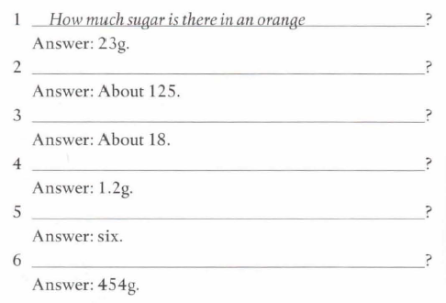
WB 58
How many colories are there in a banana
How many oranges are there in a carton of orange juice
How much salt is there in a bowl of cereal.
How many eggs are there in a box
How much jam is there in a jar.

Slide 18
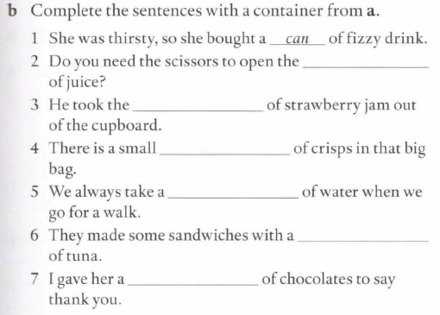
WB 59
carton
jar
packet
bottle
tin
box

Slide 19
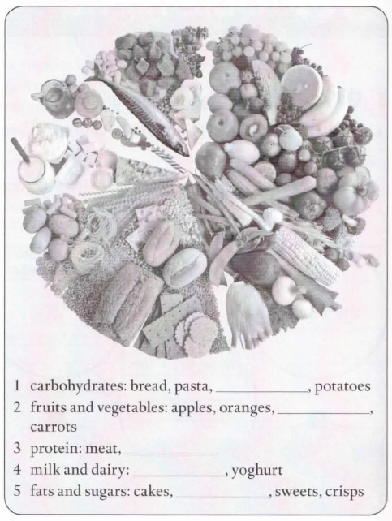
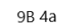
rice
peas
eggs
cheese
biscuits

Slide 20
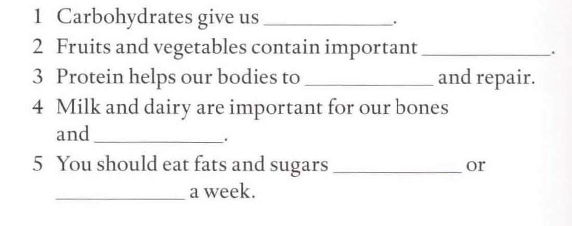
energy
vitamins
grow
teeth
once
twice

